Slide 1
Controlling Traveling-Wave Phonons at Room Temperature
Joel N. Johnson
April 25th, 2025
Northern Arizona University

Slide 2
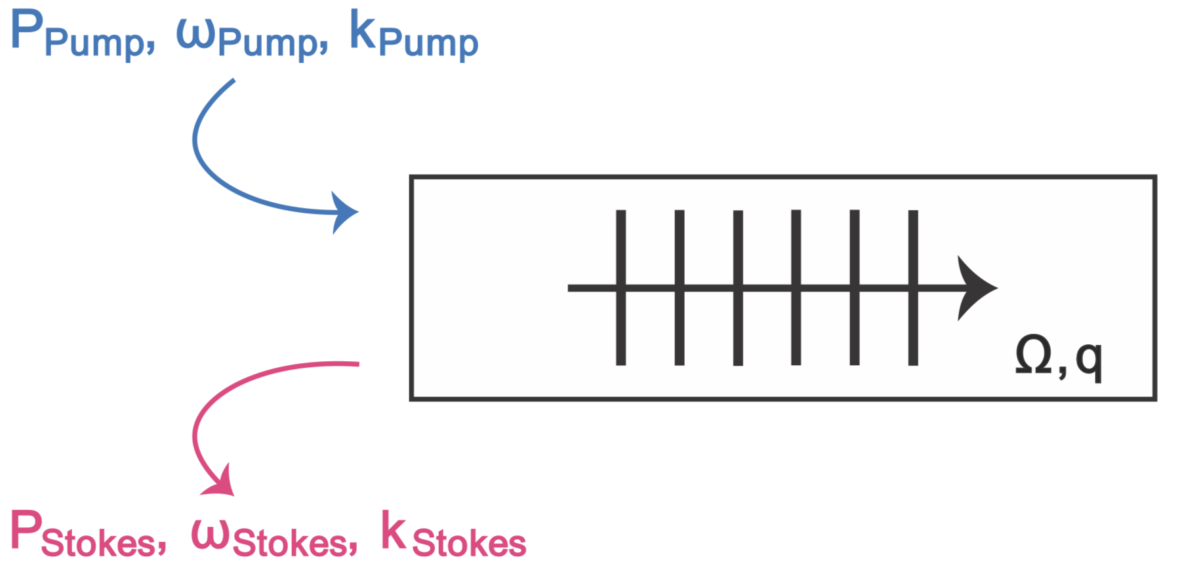
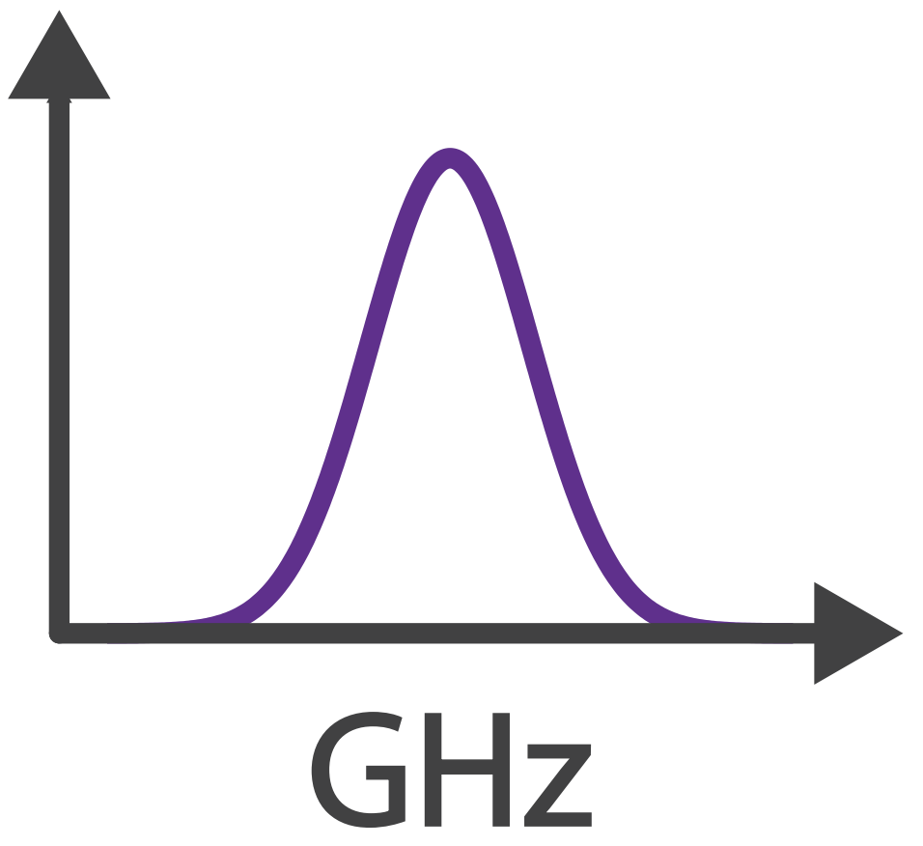
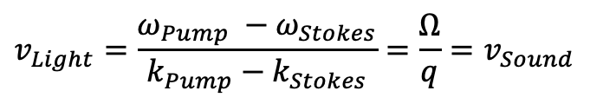



Brillouin Scattering: Optomechanical Coupling
Phase (velocity) matching:
$$v_{Light}=\frac{ω_{Pump} −ω_{Stokes}}{k_{Pump}−k_{Stokes}}=\frac{Ω}{q}=v_{Sound}$$
✓
Energy Conservation:
$$ω_{Pump}−ω_{Stokes}=Ω$$
✓
Momentum Conservation:
$$k_{Pump}−k_{Stokes}=q$$
$$Ω$$

Slide 3
Controlling Sound with Light
Laser Cooling of Traveling-Wave Phonons in an Optical Fiber
Quieting sound with light
Coherently stimulated Brillouin Scattering
Amplifying sound to measure subtle signals
Brillouin-Induced Raman Modes
Harnessing sound for engineered behaviors

Slide 4
Big picture
Why do we care about laser cooling
Discrete to continuous story
Challenges/requirements

Slide 5
Optomechanical Cooling
Material at room temperature has thermal fluctuations (phonons)
Ω
phonon

Slide 6
Optomechanical Cooling
Material at room temperature has thermal fluctuations (phonons)
Laser light
Ω
⍵
phonon

Slide 7
Optomechanical Cooling
Material at room temperature has thermal fluctuations (phonons)
Laser light backscatters off approaching sound wave (Brillouin scattering)
Ω
⍵
phonon

Slide 8
Optomechanical Cooling
Material at room temperature has thermal fluctuations (phonons)
Laser light backscatters off approaching sound wave (Brillouin scattering)
Energy transfers from sound to light:
Returning light is frequency upshifted (blue-shifted)
⍵’ = ⍵ + Ω
Ω
⍵
phonon

Slide 9
Optomechanical Cooling
Material at room temperature has thermal fluctuations (phonons)
Laser light backscatters off approaching sound wave (Brillouin scattering)
Energy transfers from sound to light:
Returning light is frequency upshifted (blue-shifted)
Sound wave intensity is lowered (cooled)
⍵’ = ⍵ + Ω
Ω
⍵
phonon

Slide 10
Optomechanical Cooling
Material at room temperature has thermal fluctuations (phonons)
Laser light backscatters off approaching sound wave (Brillouin scattering)
Energy transfers from sound to light:
Returning light is frequency upshifted (blue-shifted)
Sound wave intensity is lowered (cooled)
⍵’ = ⍵ + Ω
Ω
⍵
phonon

Slide 11
Optomechanical Cooling
Material at room temperature has thermal fluctuations (phonons)
Laser light backscatters off approaching sound wave (Brillouin scattering)
Energy transfers from sound to light:
Returning light is frequency upshifted (blue-shifted)
Sound wave intensity is lowered (cooled)
Anti-Stokes
⍵’ = ⍵ + Ω
Ω
⍵
phonon

Slide 12
Optomechanical Heating
Material at room temperature has thermal fluctuations (phonons)
Ω
phonon

Slide 13
Optomechanical Heating
Material at room temperature has thermal fluctuations (phonons)
Laser light
Ω
⍵
phonon

Slide 14
Optomechanical Heating
Material at room temperature has thermal fluctuations (phonons)
Laser light backscatters off retreating sound wave (Brillouin scattering)
Ω
⍵
phonon

Slide 15
Optomechanical Heating
Material at room temperature has thermal fluctuations (phonons)
Laser light backscatters off retreating sound wave (Brillouin scattering)
Energy transfers from light to sound:
Returning light is frequency downshifted (red-shifted)
⍵’ = ⍵ - Ω
Ω
⍵
phonon

Slide 16
Optomechanical Heating
Material at room temperature has thermal fluctuations (phonons)
Laser light backscatters off retreating sound wave (Brillouin scattering)
Energy transfers from light to sound:
Returning light is frequency downshifted (red-shifted)
Sound wave intensity is increased (heated)
⍵’ = ⍵ - Ω
Ω
⍵
phonon

Slide 17
Optomechanical Heating
Material at room temperature has thermal fluctuations (phonons)
Laser light backscatters off retreating sound wave (Brillouin scattering)
Energy transfers from light to sound:
Returning light is frequency downshifted (red-shifted)
Sound wave intensity is increased (heated)
⍵’ = ⍵ - Ω
Ω
⍵
phonon

Slide 18
Optomechanical Heating
Material at room temperature has thermal fluctuations (phonons)
Laser light backscatters off retreating sound wave (Brillouin scattering)
Energy transfers from light to sound:
Returning light is frequency downshifted (red-shifted)
Sound wave intensity is increased (heated)
Stokes
⍵’ = ⍵ - Ω
Ω
⍵
phonon

Slide 20
CoBS

Slide 21
Raman

Slide 22
Conclusion

